Slide 1
THE IRON WOLF
The legend about the foundation of VILNIUS,
the capital city of Lithuania

Slide 2
The summary of the legend in a flow map
In Lithuania in the XIII century there were dense oak woods full of aurochses, wolves, lynxes, birds.
Duke Šventaragis ordered to build a sanctuary for the God called Perkunas.
Grand Duke Gediminas, who lived in Trakai at that time, with his courties used to go hunting into remote lands.
Around 1322 Duke Gediminas was chasing an aurochs and killed it on the hill.
During the night Duke Gediminas dreamt about a large wolf in iron amour howling with a voice of a hundred wolves.
A local sage Lizdeika was called to interpret the dream for Gediminas.
Duke Gediminas blew a horn to mark a successful hunt.
After the hunt and good supper, the hunters fell asleep.
Lizdeika told him that the wolf’s iron armor and loud voice meant that a powerful fortress would be built and its fame would be heard far
Gediminas promptly gave orders to build a fortress on the hill and moved his headquarters to this site.
The city of Vilnius, the current capital of Lithuania, grew up around it.

Slide 3
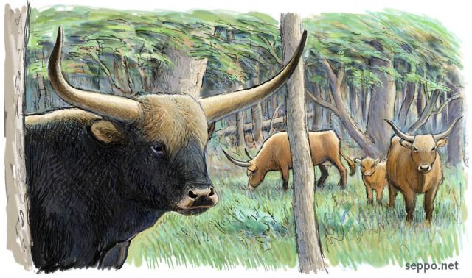
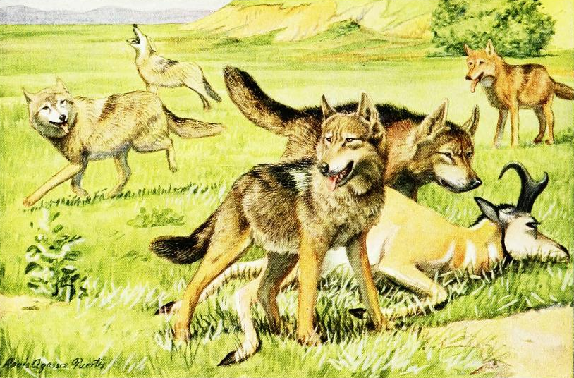
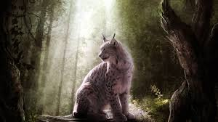
Near the present location of Vilnius palace, in the XIII century there were dense woods. An enormous aurochs - the king of Lithuania’s forests – awakened hundred-year-old oaks with his strong voice, at nights the echo of the wolves’ howl reverberated great waters of the river Neris and vanished in the distance, as if carried by the waters of the river and dispersed throughout Lithuania. The rapacious lynx, hiding in the thicket, lurked for its prey

Slide 4
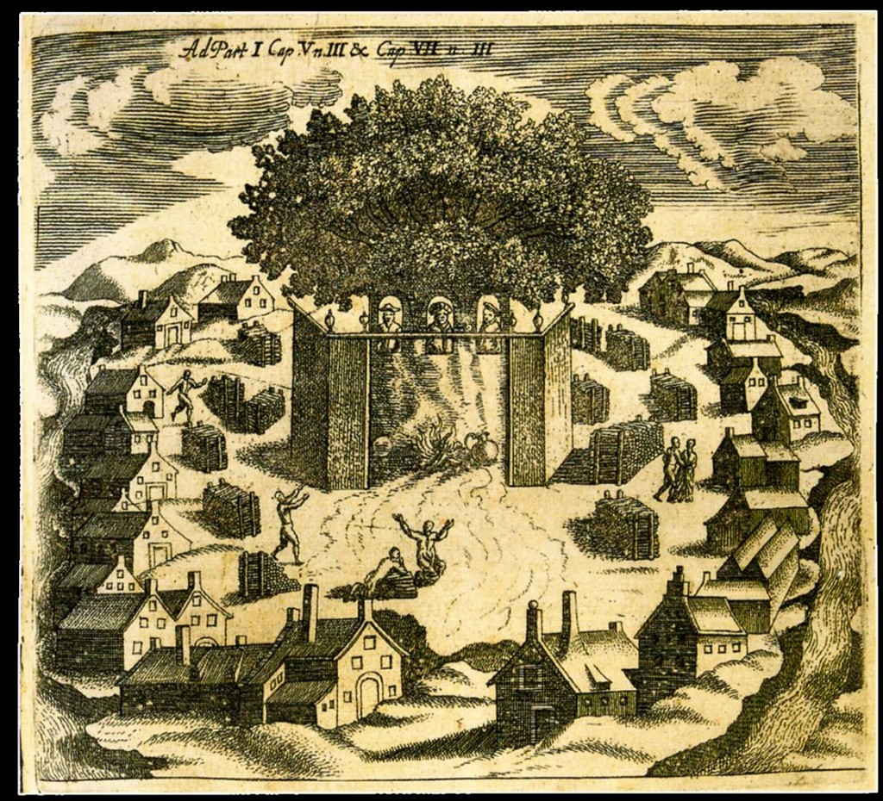
That’s why it was hardly surprising that these woods allured so many hunters. The woods were so great that Duke Šventaragis while hunting spotted them and ordered here in the confluence of the river Vilnia and Neris, in the valley of great hills to build the biggest sanctuary for the God called Perkunas, designating priests, senior priests and priestesses to guard the holy fire. Since then this valley was dubbed as the Šventaragis valley.

Slide 5
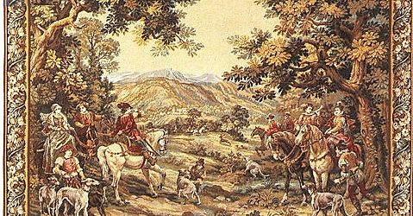
Grand Duke Gediminas like Duke Šventaragis was fond of hunting too. Grand Duke Gediminas then lived in his new capital city of Trakai, which hosted a sturdy castle on an island in the middle of Lake Galvė. Duke Gediminas with his courtiers, noblemen of Lithuania and guardsmen often used to go hunting into remote lands.

Slide 6
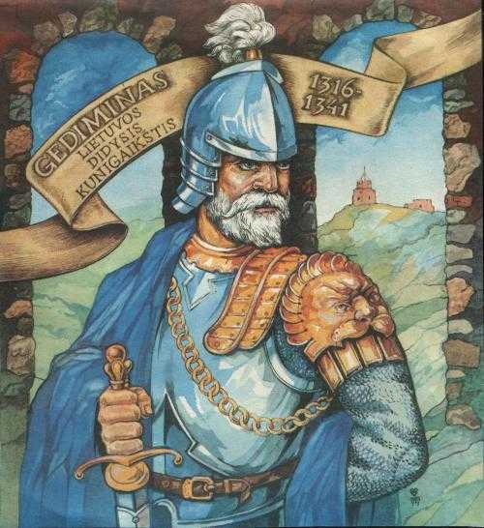
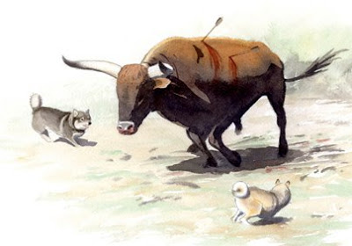
Once - some time in 1332 –Duke Gediminas while on a chase of an enormous aurochs, followed the beast to the top of the hill, where the river Vilnia meets Neris, and killed it.

Slide 7
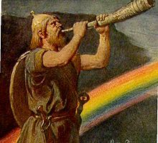
The huge beast was killed by shooting an arrow straight through his heart. The Duke placed his leg on the head of the beast and blew the song of victory into his golden horn. The sun had already set and the pale moon was showing his bare face, illuminating the tops of oaks and pines with silver light and shimmering in the waves of the river Neris. Only in the valley, Perkūnas sanctuary holy red flame sparkled, and the priests’ songs sounded in the silence of the night.

Slide 8
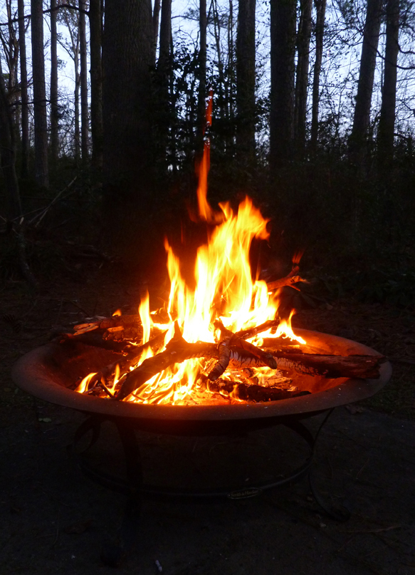
Tired of chasing animals all day long the hunters decided not to come back to Trakai and opted for a resting place between Neris and the sanctuary, where not so long ago Duke Šventaragis was cremated. After settling down and refreshing themselves with some game meat and mead, the hunters fell asleep.

Slide 9
Only Duke Gediminas couldn‘t fall asleep, but eventually tiredness defeated him and the sleep closed his eyes. He began dreaming that on the top of the hill, where he killed the aurochs, a tremendous wolf in armour appeared. The wolf itself looked like cast in iron. The wolf tilted his head to the moon and began howling. The howl was so loud it seemed like a hundred wolves were howling inside the Iron Wolf.

Slide 10
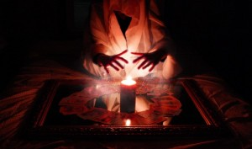
When the rays of sunshine set on hills and rivers Duke Gediminas awoke from his sleep as well. He recalled his dream and told his companions about it. As all Ancient Lithuanians, Gediminas also believed in sorcery and dreams. He believed that dreams tell the future and are sent by the Gods to advise or warn. Although none of the noblemen could answer what this sort of dream could mean, somebody from courtiers advised Gediminas to call the priest of priests Lizdeika, who at that time was known for his wisdom. The duke called for Lizdeika. When the priest came, he stood in front of the Duke, listened to his dream and pondered deeply over it. The knights of the Duke surrounded Lizdeika and followed every face expression waiting for the elucidation of the dream.

Slide 11
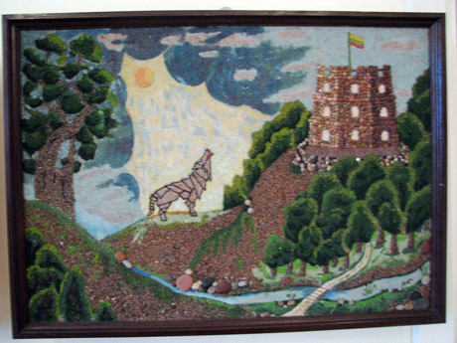
Eventually, Lizdeika, with one hand leaning on a staff, which was the symbol of his greatness, the other lifting up to the sky, solemnly spoke:
“Mighty Duke! Through this dream the gods revealed their will to you and if you fulfil it, honor and glory will await you. The Iron Wolf means that in that spot a sturdy castle and a city has to be built – the capital of the state, and the hundred wolves howling inside the Iron Wolf mean citizens who will bring fame to you and that city throughout the entire world. So you must be obedient to the will of the gods and build there a castle and a city, so the name of the city will glorify Lithuania – our homeland - throughout the ages!”

Slide 12
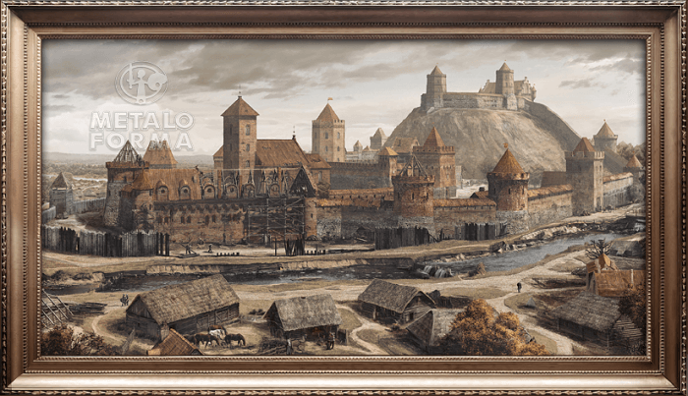
The Duke liked this explanation very much and soon after began building a castle on the hill. The castle was surrounded by a strong stone wall and two hexagon towers. Duke Gediminas named the hill Taurakalnis. In the valley of the hill another wooden castle was built and named the Lower Castle (Žemutinė), or Priests‘ Castle (Krivių). People began cutting down hundred-year-old oaks and limes and building their houses nearby.

Slide 13
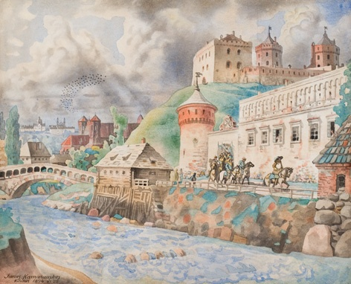
That‘s how the city was founded and named Vilnius after the river Vilnia. Later on Gediminas moved from Trakai to Vilnius which became the capital of Lithuania.
Since then the Duke commanded Lizdeika to call himself Radvila due to his excellence in dreams explanations.

Slide 14
Thank you for attention

